Slide 1
STELLATE Presentation to Digital Labs Africa

Slide 2
By Tumelo Daniel Mwaba of Orison SoftWorks 13/01/20

Slide 3
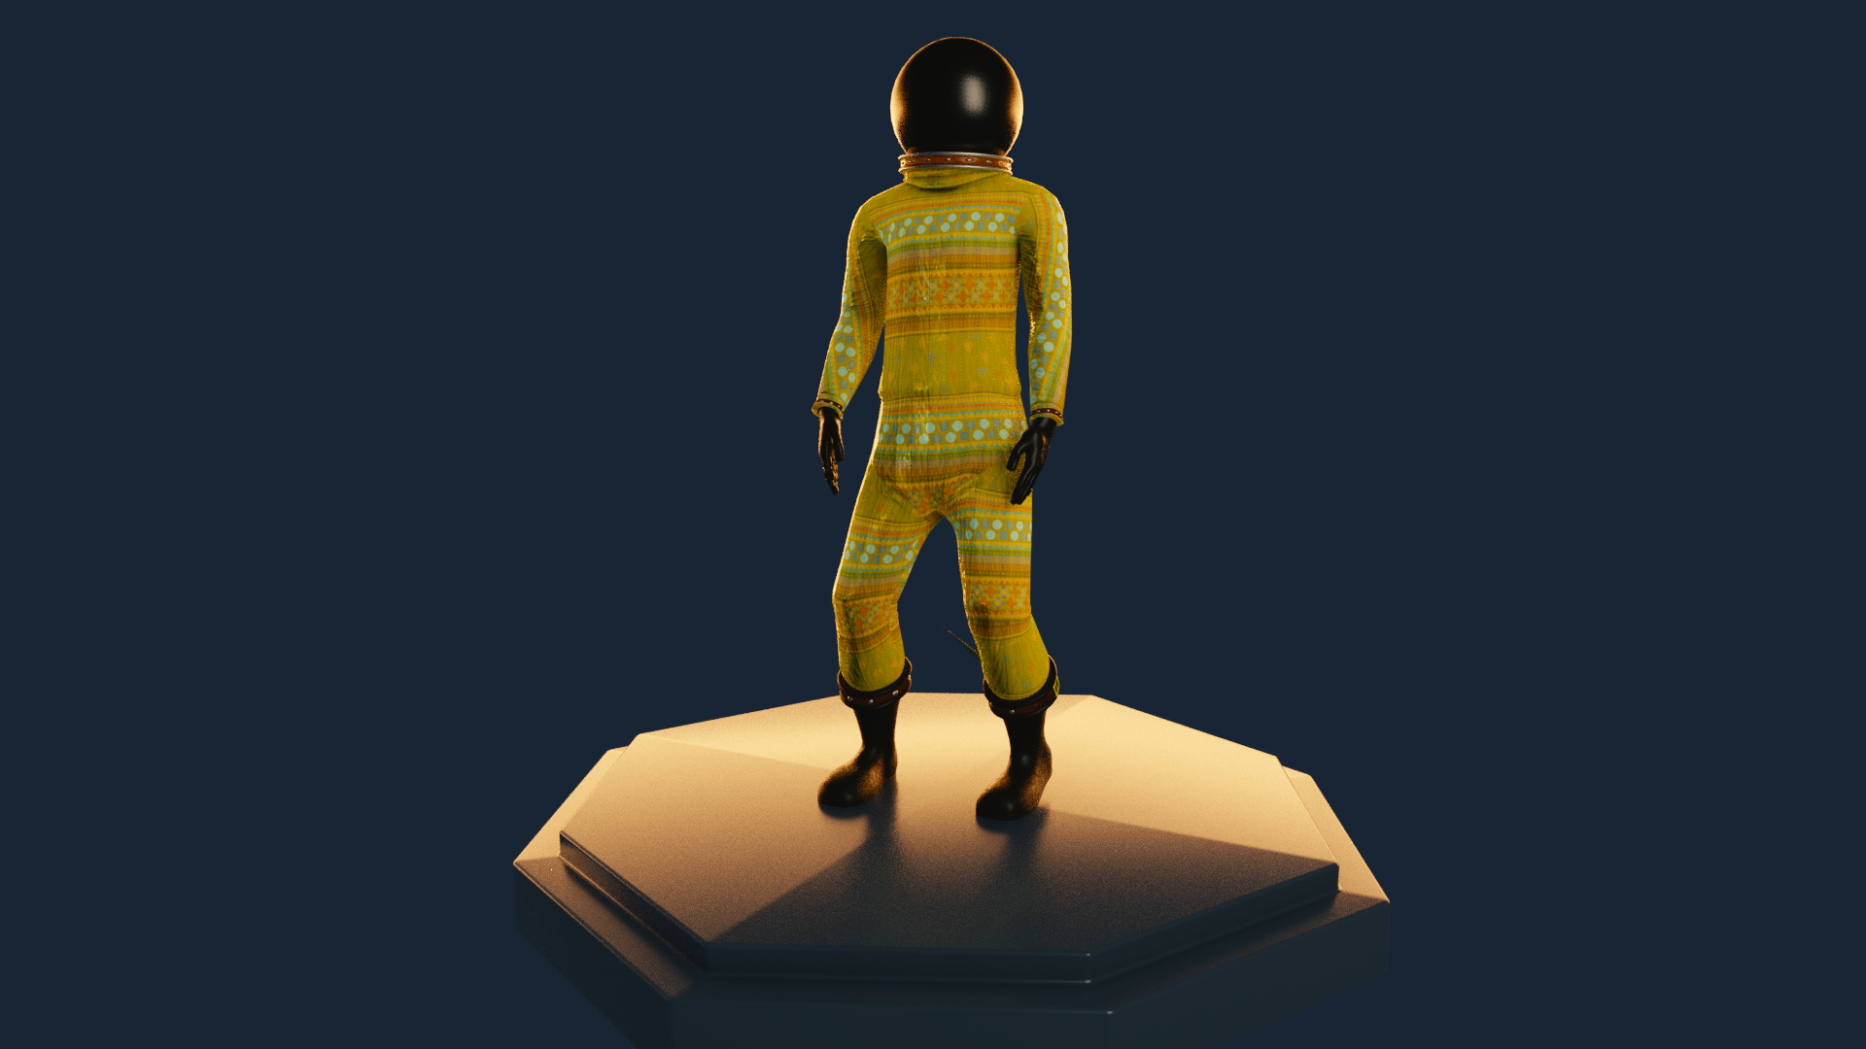

Slide 4
Overview
Stellate is a 2.5D, Side scrolling, Sci-fi, puzzle platformer game.
The game revolves around Science teacher turned Afronaut, Edward Mukuka Nkoloso, who spear-headed a space program sought to accomplish the launching of a rocket that would send him to the moon and the planet Mars during the sixties in Northern Rhodesia(Zambia)in which he hoped to beat the United States and Soviet Union's respective space programs at the height of the Space Race.
But instead, he goes through a Blackhole and finds himself in the Quantum realm in which he must journey through while being bound to the laws and properties of time-space in the quantum realm and quantum mechanics.

Slide 5
Target Audience
Stellate is intended as a platform release for the PC.
The target audience for Stellate will be fans of Puzzle, adventure and sci-fi games. Gamers experienced in Adventure Puzzle Platformers (players of Braid, Inside, Limbo, Fez and other similar titles) will find familiarity in the game, and will find the game piquing their curiosity and interest

Slide 6
Game Features
A completely immersive Linear-threaded storyline.
Quirky and edgy graphics and landscapes portraying unique new worlds.
An intricate puzzle system that ranges from the properties of time to Quantum Mechanics in the Quantum Realm.
Soundtrack featuring original soundscapes written and composed specially for this game.
English localization of all written and spoken dialog.

Slide 7
MAIN CONCEPT
The main concept of Stellate is to have the protagonist journey and find his way through the Quantum realm. The quantum realm is occupied by intricate puzzles and intelligent life forms.
The protagonist must escape the alien environment. During this quantum-realm journey and will be bound to the laws and properties of time-space in the quantum realm and quantum mechanics.
each level will have its unique properties, aesthetics and architectures.

Slide 8
MAIN CONCEPT
In order to make it through the quantum realm, the protagonist must introspectively solve platformer puzzles with regards to each level having uniquely designed puzzles that project an attribute to the laws of quantum mechanics such as superposition, the speed of light, the arrow of time and quantum entanglement.
The game also involves intelligent elements that should be outsmarted in order to progress to other areas of the quantum realm and also take you a step closer to making your way out.

Slide 9
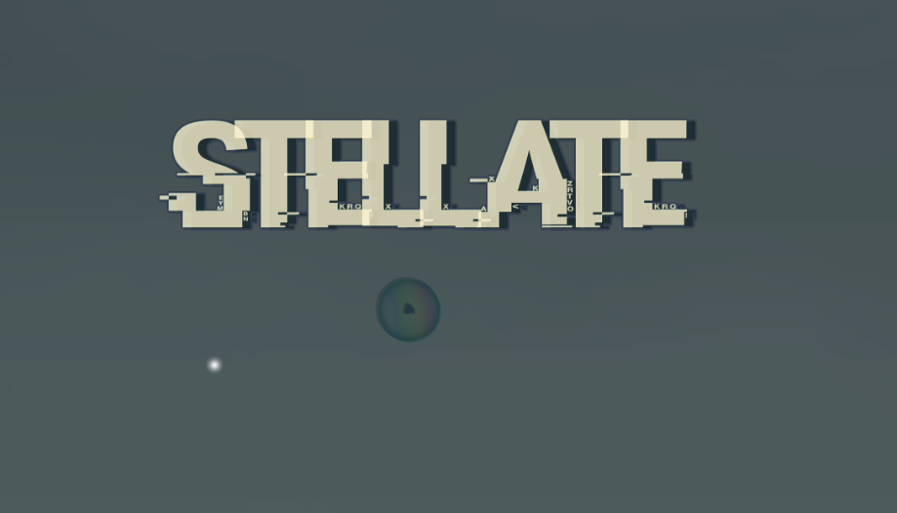
GAME SCREENSHOTS
Game Start Screen
Warp Portal
P

Slide 10
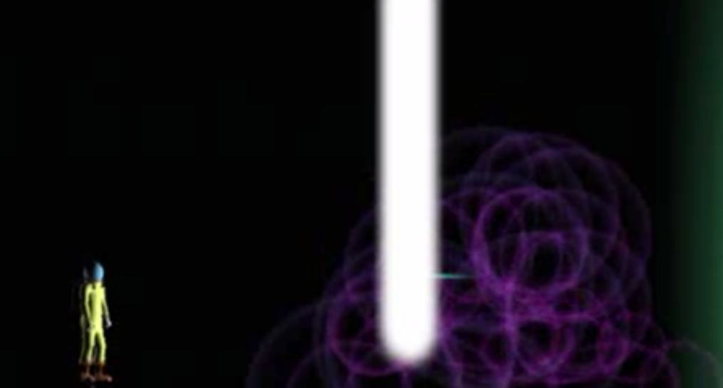
GAME SCREENSHOTS
Warp Portal
Protagonist

Slide 11
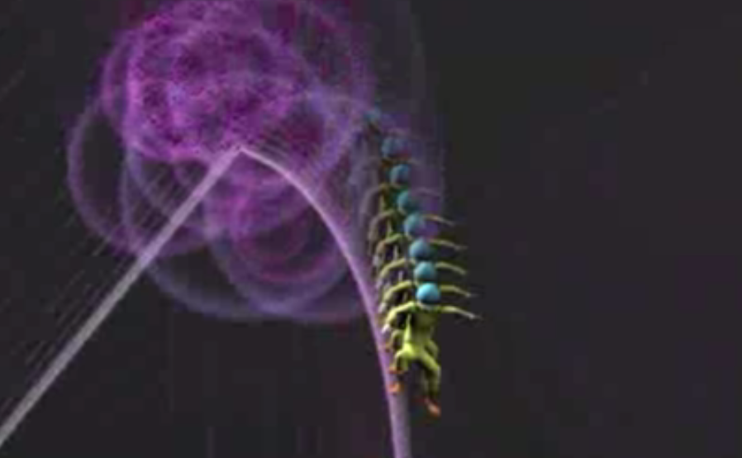
GAME SCREENSHOTS
Warp Portal
Protagonist making time
Jump through warp portal
Protaonist

Slide 12
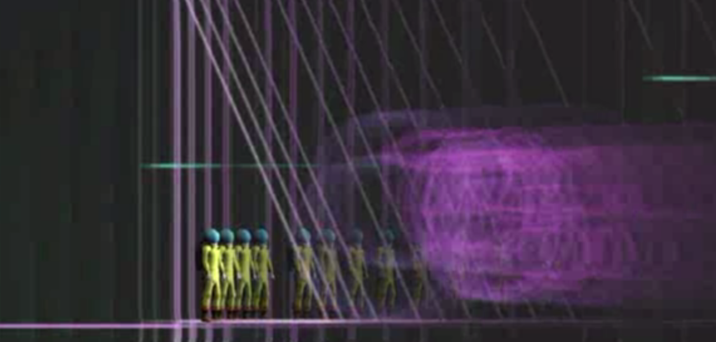
GAME SCREENSHOTS
Warp Portal
Protagonist making time
Jump through warp portal
Protaonist
Protagonist existing
In Superposition

Slide 13
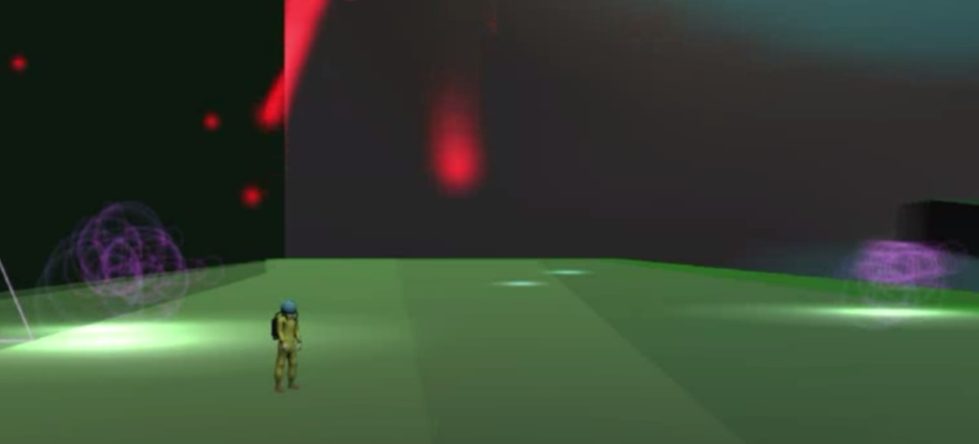
GAME SCREENSHOTS
Warp Portal
Protagonist making time
Jump through warp portal
Protaonist
Protagonist existing
In Superposition
Protagonist viewing world
In 3D perspective for only five
Seconds to figure out where the
Other portals are..

Slide 14
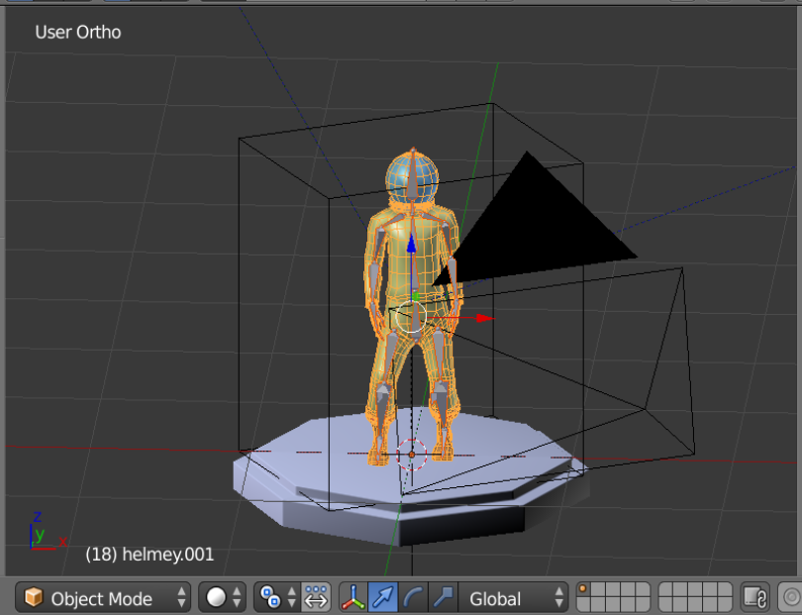
CHARACTER DESIGNS
Protagonist’s design in Blender 3D Software

Slide 15
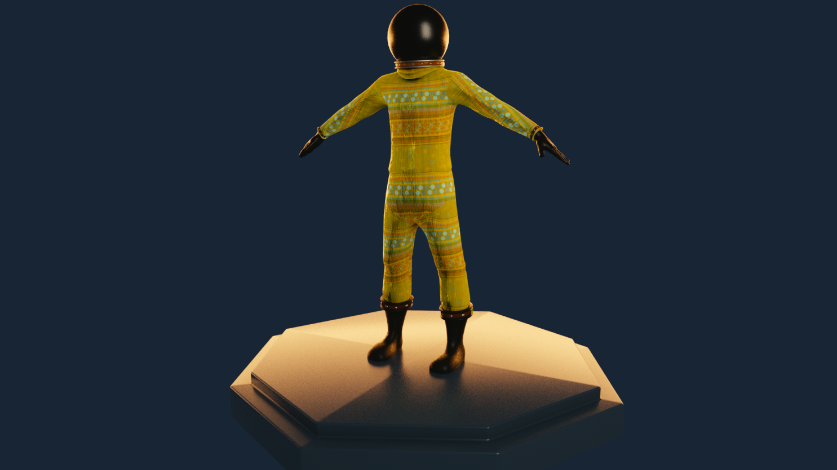
CHARACTER DESIGNS
Protagonist Rendered using Blender 3D Software

Slide 16
PROJECT STAFF
Tumelo Daniel Mwaba – Lead Programmer, Game design and development
Mukakanga Konkola – Character Modeling and Design
Ganizani Mwale – Audio/Music/SFX composer/Digital Artist
Mwauluka Nambula – Concept and Sketch Artist

Slide 17
PROJECTED BUDGET
Better equipment for development (High standard Game Development Software, Computer and GPU) – ZMK10000

Slide 18
DISTRIBUTION STRATEGY
The main platform for this video game would be on personal computers, using Steams green light program for indie game developers would help us reach a wider audience of both casual gamers and indie enthusiasts. The game will be sold for $8-10.
If we do manage to purchase a console license we can then port the video game to consoles like the playstation 4/5 and xbox one and even mobile devices.

Slide 19

STELLATE

